Slide 1
ESTIMATING EVAPORATION FROM WATER SURFACES
(With emphasis on shallow water bodies)

Slide 2
INTRODUCTION
Evaporation is rarely measured directly
Estimating methods include:
  pan coefficient x measured pan evaporation
  water balance
  energy balance
  mass transfer
  combination techniques
Emphasis will be practical methods

Slide 3
BACKGROUND
Evaporation theories – to the 8th century
Dalton (1802), E = f(ū) (e_{o} – e_{a})
Bowen (1926), the Bowen ratio, the ratio of sensible heat to latent heat gradients (Δt/Δe)
Applications were made to lake evaporation by Cummings and Richardson 1927; McEwen 1930

Slide 4
ENERGY CONSIDERATIONS
Evaporation requires a lot of energy
Incoming solar radiation is the main source
In contrast to land, not all net solar radiation is absorbed on the surface
In pure water, about 70% is adsorbed in the top 5 m (16 ft)
Solar radiation adsorbed below the surface is “stored energy”

Slide 5
ENERGY (continued)
Estimating energy storage in water (Q_{t}) can be more difficult than estimating soil heat flux (G)
Part of solar radiation may penetrate to great depths depending on the clarity of the water
Stored energy affects the evaporation rate
Example temperature profiles in deep water:
  profiles during increasing solar cycle
  profiles during decreasing solar cycle

Slide 6
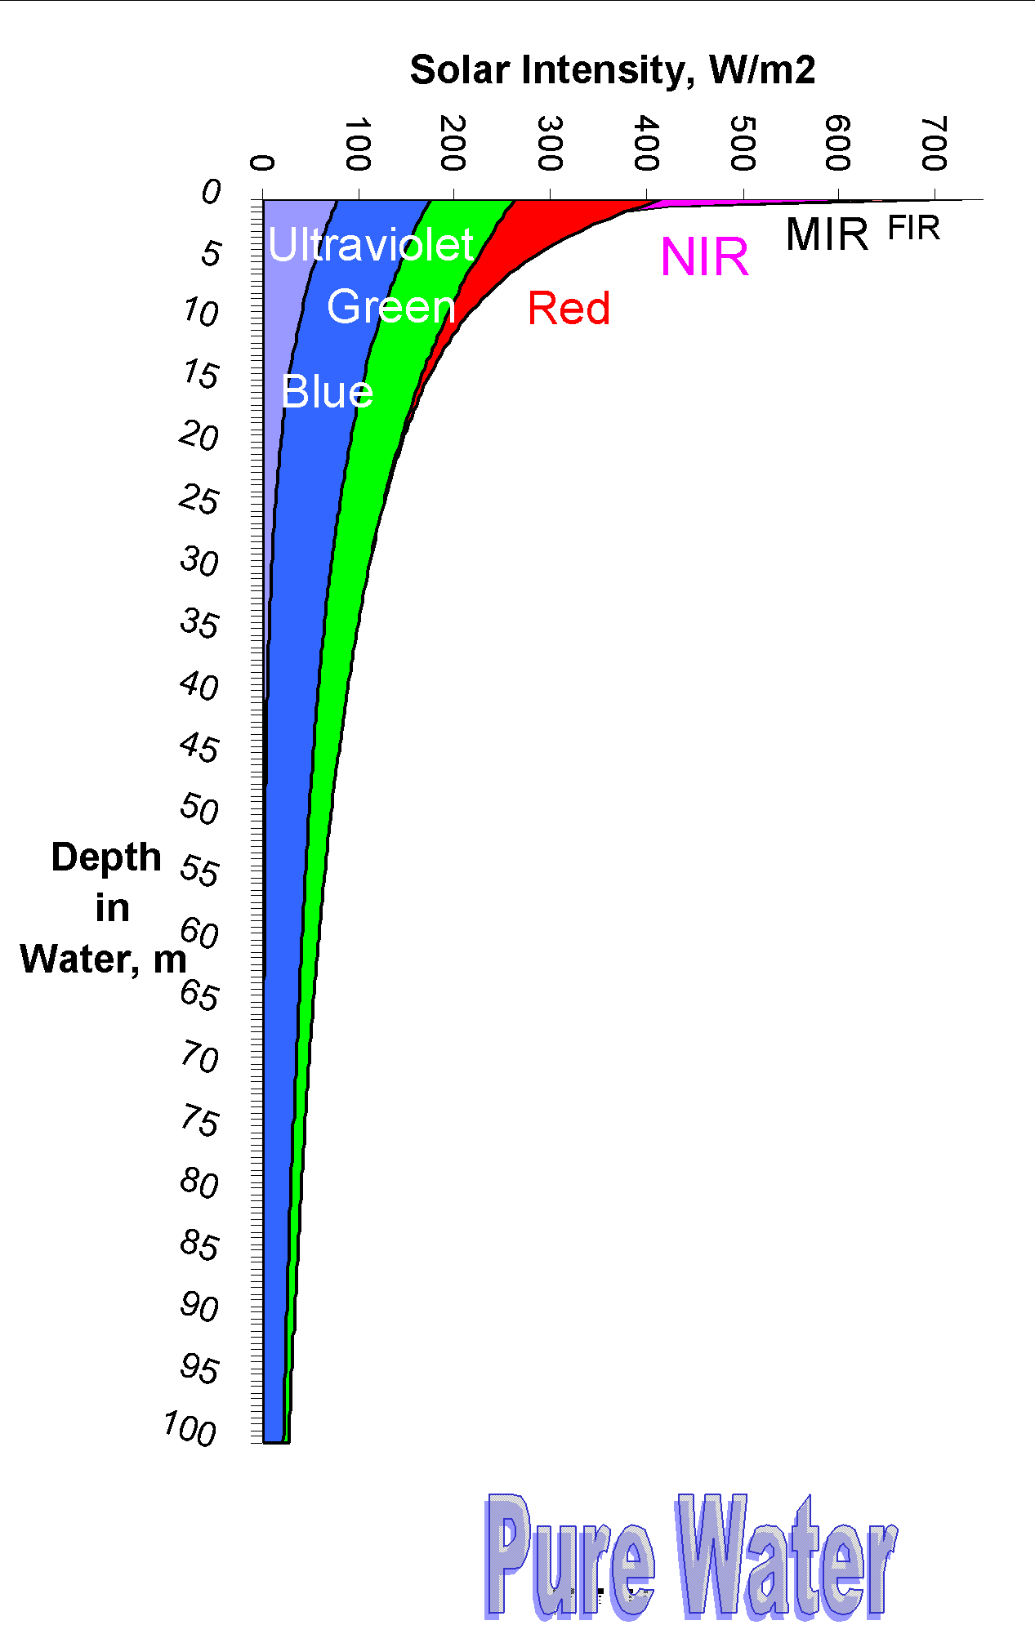
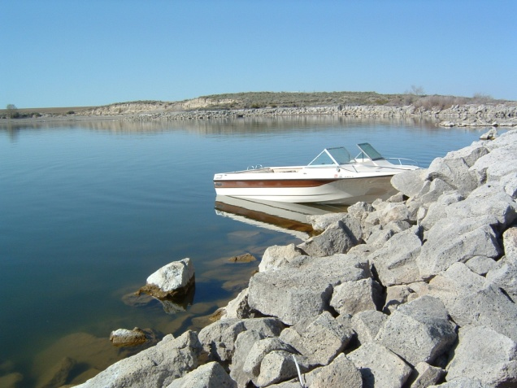
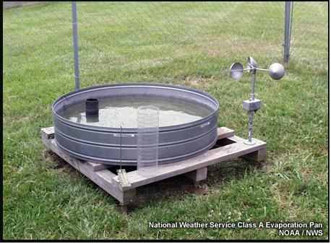
Solar Radiation Penetrates Deep in Water
Evaporation pans are two shallow and hold too much “warmth” at the surface. Therefore, they can overestimate the evaporation from large reservoirs and lakes.

Slide 7
ENERGY STORAGE & RELEASE
Lake Berryessa, 8,100 ha (20,000 ac.) and 58 m (190 ft) deep, average 40 m
Little or no inflow during the summer
Thermal profiles during increasing R_{s}
Thermal profiles during decreasing R_{s}
Example temperatures by depth and time
Reason for studying evaporation—improve estimates of evaporation to calculate inflow

Slide 8
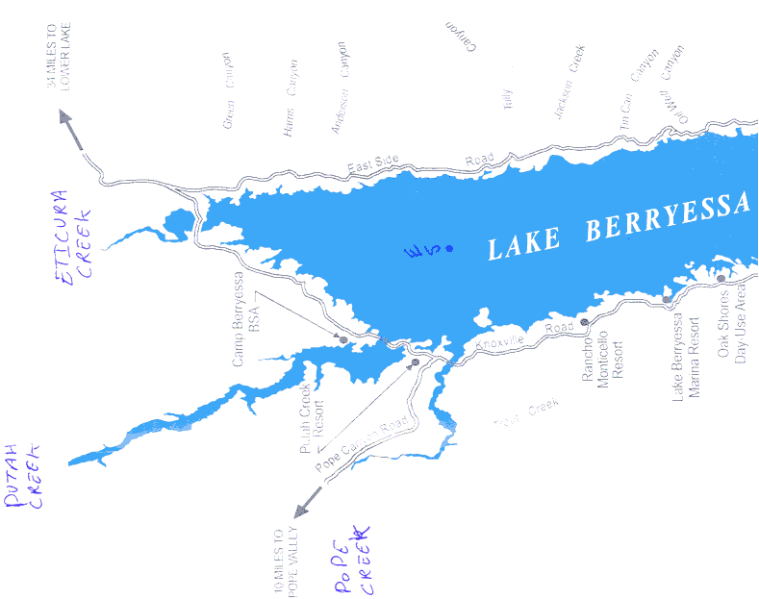
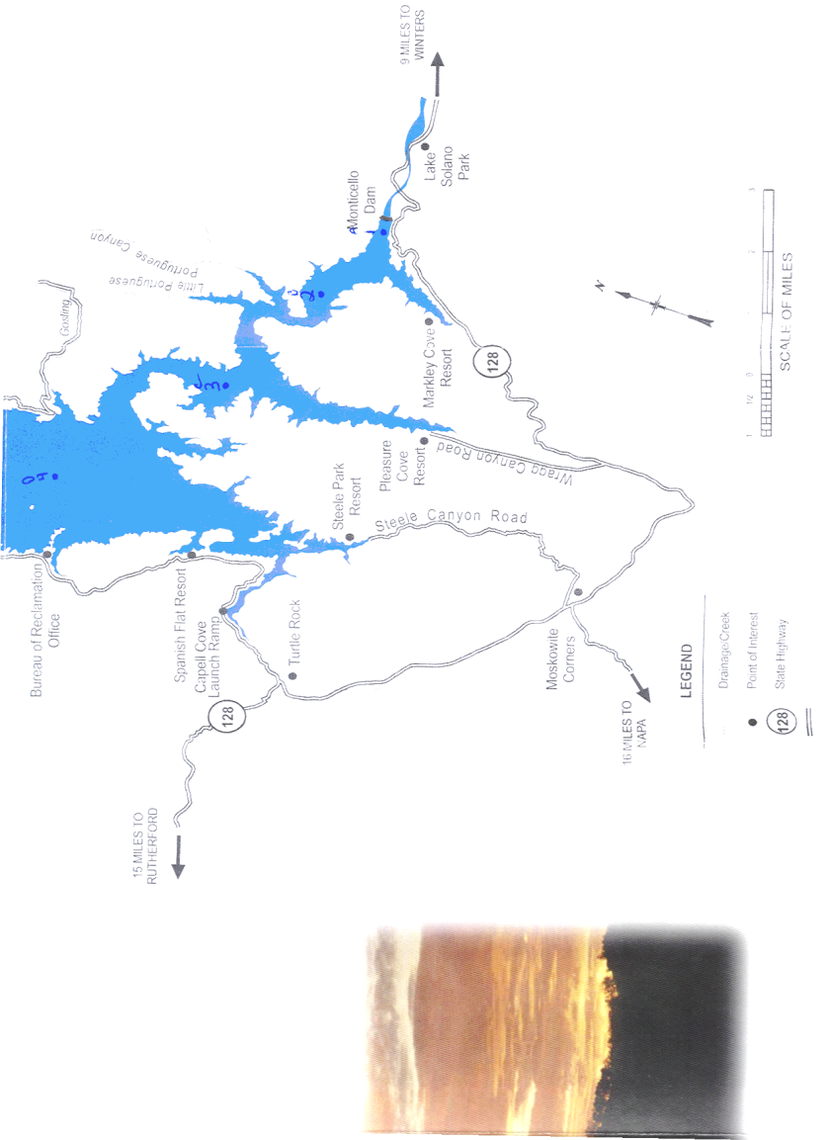
Lake
Lake
Berryessa
Berryessa
California, USA
California, USA
LB 10
LB 05
LB 12
LB 04
LB 06
(New-USBR WS)
LB 03
LB 01
Portable WS
LB 08 (Dam)
LB 09 (USBR)
LB 02
LB 07A-E
LB 11
Old-USBR WS

Slide 12
WHY STUDY EVAPORATION ON LB?
The pan site was moved from the original site
Measured pan evaporation x original coefficients underestimated reservoir evaporation and inflow
Negative inflows were calculated during low and zero inflows late in the summer
The obvious solution – move the pan site, and recheck the pan coefficients
Data were needed to justify to the USBR the need to change the pan site
View of the evaporation pan site
Estimated rate of energy storage

Slide 13
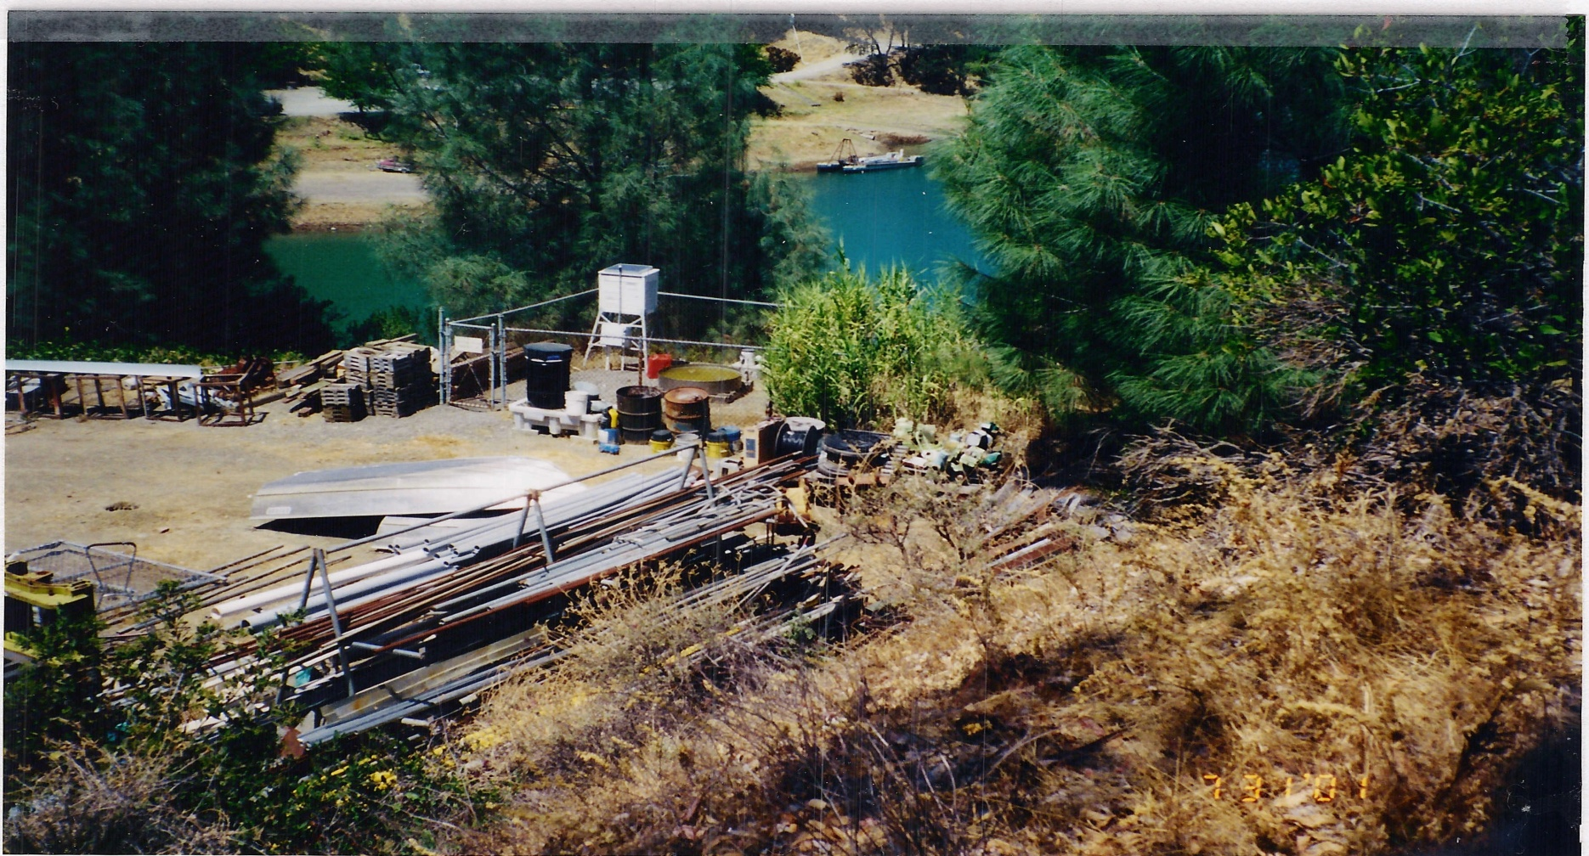
Original USBR Pan Site

Slide 14
Rate of Energy Storage

Slide 15
ENERGY STORAGE EXAMPLES
Maximum energy storage rates of 5 to 10 MJ m⁻² d⁻¹ to a depth of 25 m measured in Lake Berryessa and about 10 MJ m⁻² d⁻¹ to a depth of 45 m measured in Lake Mead
Water surface temperatures reached a maximum in July in LB and in August in Lake Mead (lag is related to depth of water)
Evaporation rate also lagged solar radiation
Advected energy can be large in reservoirs on rivers (example along Colorado River)

Slide 18
Other Methods
Water budget procedure
Aerodynamic methods
  used mainly on large lakes and reservoirs
Example – American Falls reservoir in Idaho by Allen et al.
  estimates using water and air temperature
  estimated evaporation relative to ET_{r}
Why the low summer rate? Cold inflow water?

Slide 19
Temperature of water from American Falls outfall follows Temperature of Air
Year 2000
Year 2004

Slide 20
Evaporation ratio for Alfalfa Reference ET

Slide 21
SHALLOW WATER BODIES
Early estimating methods
  Equilibrium temperature (Edlinger et al. 1968)
  Further developed and tested by Keijman (1974), Fraederich et al. (1977), de Bruin (1982), and Finch (2001)
Finite difference model (Finch and Gash, 2002)
Pan evaporation x pan coefficient
Energy balance and combination methods
Reference ET x coefficient (E = ET_{o} x K_{w})

Slide 22
EVAPORATION PAN COEFFICIENTS
Pan coefficient studies
Rohwer (1931) – a classic detailed study conducted on the CSU campus
Rohwer compared evaporation from a Class A pan and an 85-diameter (26 m) reservoir
Young (1947) also did a classic study in CA
Others: Kohler (1954); Kohler et al. (1959); Farnsworth et al. (1982)
Fetch effects and obstructions (fixed & variable)

Slide 27
Obstructions
Fixed
  buildings
  shelter belts
  other (shown in previous example)
Variable
  adjacent corn field (most common), can have a major effect
  weeds and other adjacent crops

Slide 28
OTHER ESTIMATING METHODS
Aerodynamic (used mainly on large water bodies)
Energy balance (requires detailed measurements)
Combination methods: Penman (1948, 1956, 1963); Penman-Monteith (1965); Priestley-Taylor (1972)
All require estimating net radiation using standard equations and estimating energy storage (more difficult for deep water bodies)
Reference ET x coefficient (E = ET_{o} x K_{w})
  for shallow water bodies
  for ice-free water bodies

Slide 29
ENERGY STORAGE RATES
Difficult to quantify without measurements
Example rates of storage
  peak rates can range from 5 to 10 MJ m⁻² d⁻¹
  equivalent to 2 to 4 mm d⁻¹ evaporation
Example rates calculated from lake studies
  Pretty Lake in Indiana
  Williams Lake in Minnesota

Slide 31
ASCE-EWRI REFERENCE ET
ASCE-EWRI (2005) and Allen et al. (1998)
ET_{ref} x coefficient for open ice-free water (K_{w})
where ET_{ref} is for short grass (ET_{os}), mm d⁻¹
First check input weather data for quality

Slide 32
EXAMPLE – HOME LAKE, CO
Location San Luis Valley
  Elevation 2297 m (7536 ft) above sea level
  Average depth, about 1.5 m (5 ft)
Estimated energy storage
Estimated evaporation
  May-October
  ET_{ref} x K_{w} also agrees with PM in November
Results (May-October)

Slide 35
ROHWER’S CLASS A PAN COEFFICIENTS
K_{p} by months for Colorado:
Based on mean ratios (polynomial)
  Apr 0.60 August 0.75
  May 0.63 September 0.78
  June 0.67 October 0.77
  July 0.71
  Average, April-October 0.70

Slide 36
ESTIMATED EVAPORATION
HOME LAKE – MAY-OCT.
PM Penman NWS-33 ET_{ref} x 1.10
mm
(inches)
894 906 890 892
(35.2) (35.7) (35.0) (35.1)
Percent of PM
100 101 100 99.8
All give similar values for May through October

Slide 37
ESTIMATED EVAPORATION
LAKE BERRYESSA (3 YR AVG)
PM Penman P-T USBR original
mm
(inches)
1,325 1,425 1,277 955
(52.2) (56.1) (50.3) (37.7)
100 108 96 72
The same R_{n} and Q_{t} used for first three methods
Values confirm effects of “poor pan site”
P-T equation does not have wind speed

