Slide 1
Using the Best Science to Estimate Consumptive Use
March 12, 2010

Slide 2
CDSS Goal
“Provide the capability to develop credible information on which to base informed decisions concerning water resource management issues.”

Slide 3
How does Colorado’s Decision Support System Help Colorado Water Planners use the Best Science?

Slide 4
Colorado Water Rights and Supply Planning Background
Water right changes require extended period analysis of historical crop CU (~ 50 years)
Planners make decisions based on long-term hydrology and climate data that represents wet, dry, hot, cool periods

Slide 5
Colorado Limitations
Higher elevations and western slope areas do not have climate stations recording daily data required for methods incorporating better science (ex. ASCE Penman)
Daily data required for detailed methods in other areas of the State only available in recent periods
Historical satellite imagery may not be available for Energy-Balance Methods
Notes:
Ray – pitch CoAgMet stations on western slope here.

Slide 6
As a Result:
Colorado water right consultants and water planners rely heavily on less data intensive monthly methods, generally Blaney-Criddle
However:
Colorado’s Decision Support System helps mitigate limitations of those monthly methods

Slide 7
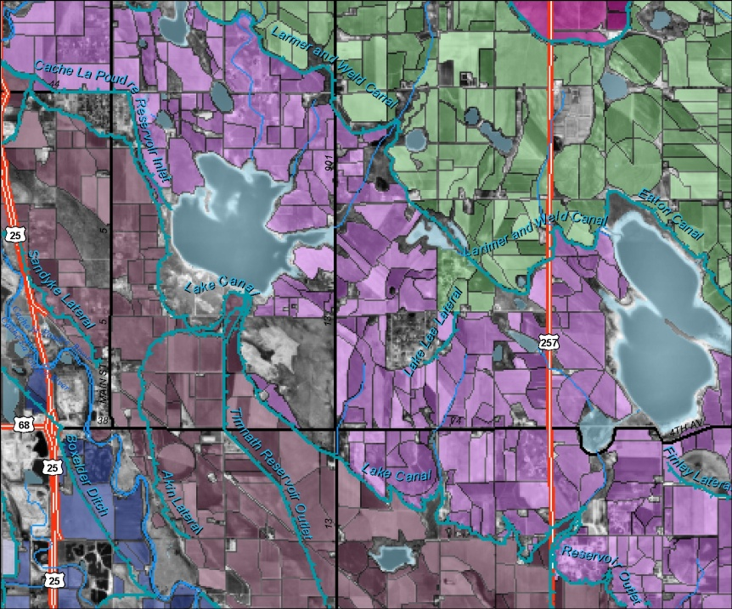
CDSS – Development and Management of “Best Data”
State-wide Irrigated Acreage Assessments
Crop Type
Irrigation Method
Source (Ditch and/or Well)
Goal 5-year Snapshots
GIS and Stored in HydroBase
Water Supply Data
Daily Diversion Records, Pumping Data
Stored in HydroBase
Notes:
Quality Reviewed Data in HydroBase

Slide 8
CDSS – Development and Management of “Best Data”
Climate Data “Managed” in HydroBase
NOAA Stations
CoAgMet Stations
Planning-Level Estimates
Specific Conveyance Efficiencies
Maximum Application Efficiencies
Available Water Content
Technical Documents Describing Estimate Procedures and Results

Slide 9
CDSS Data-Centered Approach
Consumptive Use Model StateCU
HydroBase
(Central Database)
Data Management Interfaces
Surface Water Model StateMod
Results for Decision Makers
GIS Coverages
Groundwater Model MODFLOW
Notes:
Reproducible and tranaparent

Slide 10
CDSS – Development and Management of “Best Data”
Development/Review of Locally Calibrated Blaney-Criddle Crop Coefficients
Based on Lysimeter Studies, where available
Upper South Platte Basin, Gunnison Basin, Rio Grande
Based on ASCE Penman
Lower South Platte

Slide 11
CDSS – Development and Management of “Best Data”
Coefficient Development Documented, Peer Reviewed, and Stored in HydroBase
Basin-Wide Crop Irrigation Requirements and Supply-limited CU Datasets Available
Yampa River Basin White River Basin
Colorado River Basin Gunnison River Basin
San Juan River Basin Rio Grande Basin
South Platte Basin North Platte River Basin
Basin-Wide Datasets are Structure Based
Notes:
Datasets are available and can be used as-is or as a starting point for more detailed analysis.

Slide 12
What is StateCU
The State of Colorado’s Consumptive Use Model
Developed to Estimate and Report Crop Consumptive Use within the State
Publically Available
Enhancements/Additions are Peer Reviewed
Comprehensive Documentation/User Guide

Slide 13
What is StateCU?
StateCU ET Methods include:
Modified and Original Blaney-Criddle (monthly)
Pochop Bluegrass (monthly)
Penman Monteith, ASCE Penman, Modified Hargreaves (daily)
StateCU Effective Precipitation Methods include:
TR-21 SCS Method (monthly)
USBR Method (monthly)
Maximum per Day, Fraction per Day, SCS NEH4 method (daily)

Slide 14
What is StateCU?
Includes Water Supply-Limited Options
Includes River Diversions, Well Pumping, Off-Channel Supplies (reservoirs, tail water)
Considers Conveyance, Application Efficiencies
Performs On-farm Soil Accounting
Includes Water Rights Options
Historical CU senior, junior to specific water right (ex. Upper Gunnison CU subordinated to Aspinall Unit water right)
Historical CU senior, junior to daily call

Slide 15
Why was StateCU Developed?
CDSS Need for a Consumptive Use Analysis Tool
Need for Tool that could be Applied State-wide
Need to Standardize the Approach and Tools Used by CWCB and DWR

Slide 16
How is StateCU Used by Consultants?
Start with Basin-wide Dataset Developed for CDSS
Use CDSS Estimated Acreages, Efficiencies, AWC for initial estimates of Historical CU for Water Right transfers
Refine input files (through StateCU GUI) with site-specific or user-supplied detail
Use StateCU HydroBase Wizard to build CU analysis directly
Acreage, Diversion Records, Climate Data

Slide 17
StateCU Scenario Wizard
The StateCU Scenario Wizard is an interactive tool that guides the user step-by-step through the development of a new monthly scenario and pulls required input data directly from HydroBase through an internet connection.
The StateCU Scenario Wizard can be used to create a new monthly Climate Station Scenario or a Structure Scenario. Required data (e.g. climate data, diversion records, crop characteristics) is pulled directly from HydroBase via an active internet connection and formatted into the correct input files.

Slide 18
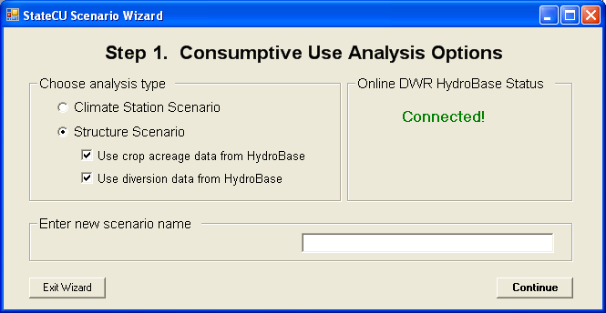
StateCU Scenario Wizard

Slide 19
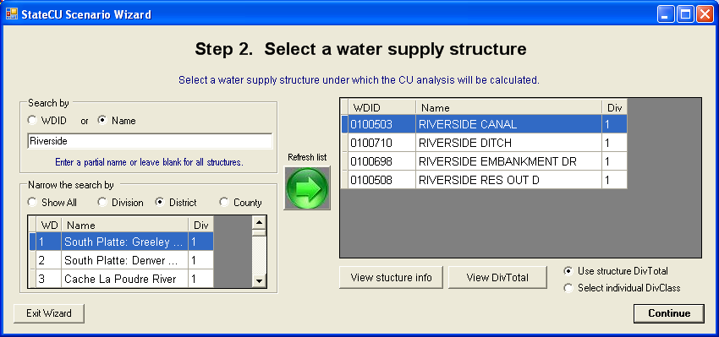
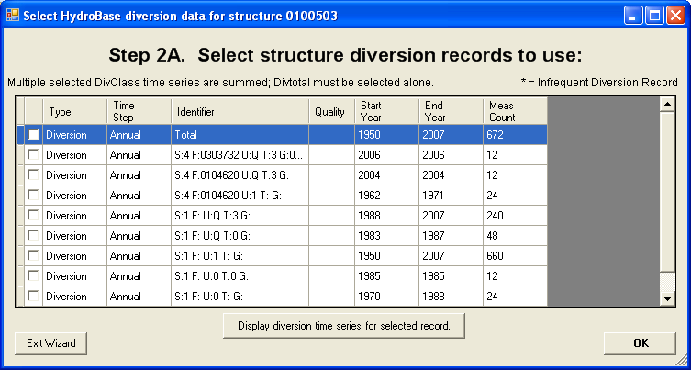
StateCU Scenario Wizard

Slide 20
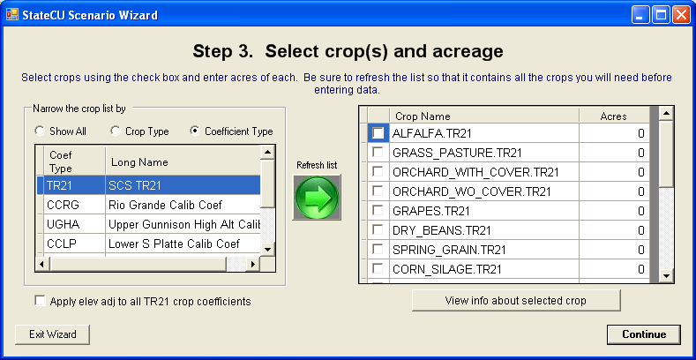
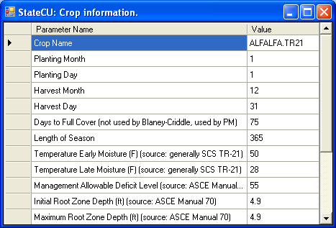
StateCU Scenario Wizard
Climate stations, and their climate data, that are currently loaded in HydroBase are the only stations available for inclusion in the scenario through the Wizard. The user can either search by the name of the climate station or by the ID.

Slide 21
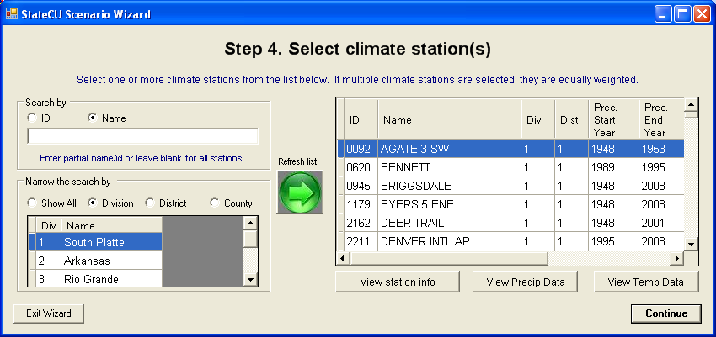
StateCU Scenario Wizard

Slide 22
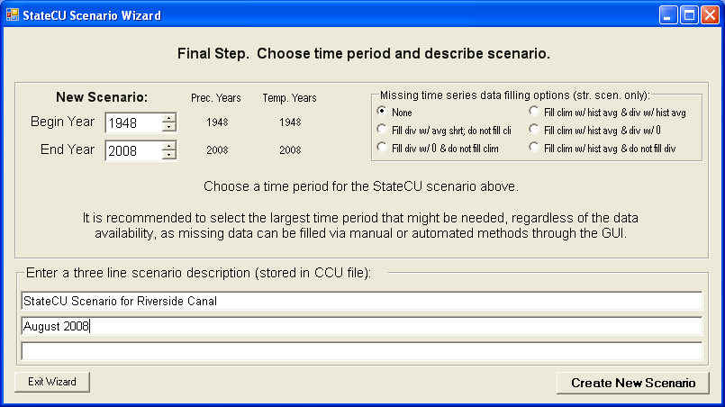
StateCU Scenario Wizard
Several parameters and modeling options are not specifically input by the user into the Wizard, rather it is the responsibility of the user to review and edit these parameters through the GUI.

Slide 23
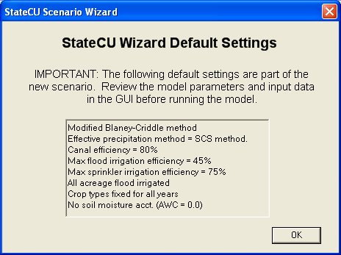
StateCU Scenario Wizard

Slide 24
Contacts
Website URL
cdss.state.co.us
Ray Alvarado – CWCB Water Information Section Chief
ray.alvarado@state.co.us
303.866.3441

