Slide 1
CALIBRATION FOR HISTORICAL CROP ET ESTIMATES
Introduction and Issues
Evapotranspiration Workshop
March 12, 2010
Ft Collins CO
Thomas W. Ley, PhD, PE

Slide 2
Why Calibration?
Most historical consumptive use analyses based on long evaluation period
Long periods of record available at many NOAA Coop Observer network (max/min/precip) stations
Simple temperature-based methods
Limited period of record at electronic weather stations (20 years or less)

Slide 3
Why Calibration?
Published studies have generally shown the simpler temperature-based ET estimation methods are inaccurate, especially in arid and semi-arid climates
Local calibration/verification is strongly recommended to obtain more accurate historical crop ET estimates

Slide 4
Approach
Compute calibration coefficients for some specific time interval during growing season (e.g., 10-days, monthly)
Measured Crop ET
Calibration coeff. =
Crop ET by method being calibrated
In the absence of measured ET (i.e., lysimeter), use crop ET based on ASCE Std Ref-ET Eqn

Slide 5
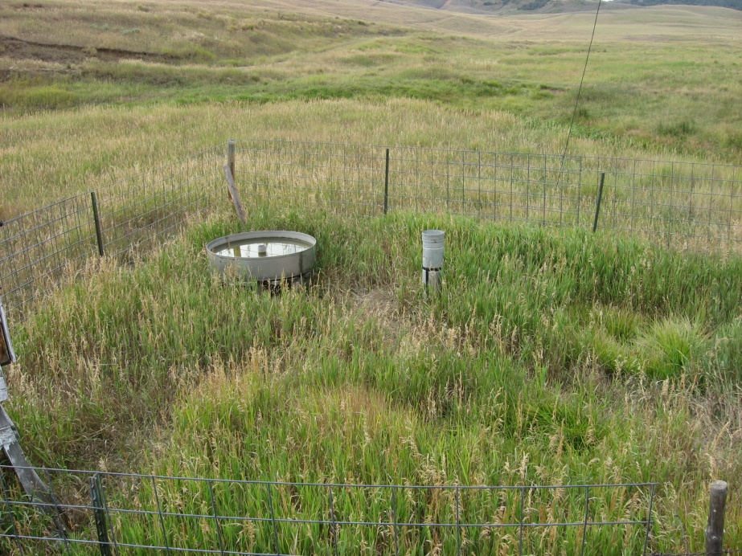
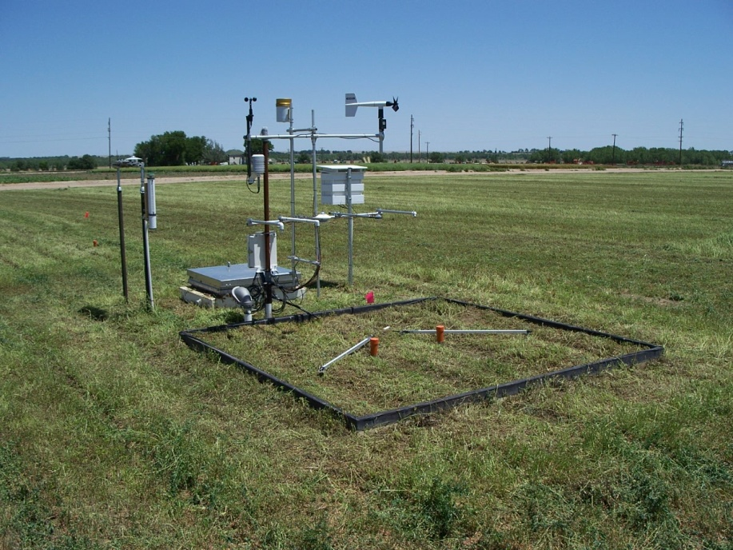
Measured Crop ET
Lysimetry
ASCE Std Reference ET
Wind direction
Wind speed
Solar radiation
Air temperature
Relative humidity
Rainfall
Holly02 CoAgMet Station
July 2005

Slide 6
Approach
Compute average calibration coefficient values for overlapping period of record
Monthly time step
Minimum 5-7 years of overlapping record

Slide 7
Modified Blaney-Criddle Method (TR-21)
u = k_{c} (k_{t}) (t x p) / 100
u = monthly consumptive use (inches)
k_{t} = climatic coefficient
= 0.173 * t - 0.314
k_{c} = crop growth stage coefficient
t = mean monthly air temperature (°F)
p = monthly percentage of annual daylight hours

Slide 8
Modified Blaney-Criddle Method
Data required--mean monthly temperature
100’s of max/min/precip stations in Colorado
Developed for irrigation planning
k_{t} (t * p) / 100 not representative of the impact of meteorological elements

Slide 9
Extraterrestrial Radiation & Percent of Daylight as a Percentage of Maximum

Slide 10
Modified Blaney-Criddle Method
Crop factor, k_{c} , is not a crop coefficient in the same sense as the reference ET-crop coefficient approach
Contains a meteorological component
location bias
values not geographically transferable (ASCE Manual 70, 1990; USDA-NRCS, 1993)
Ignore k_{c} and calibrate just the factor: k_{t} (t * p) / 100

Slide 11
1985 Hargreaves Method
ET_{o} = grass reference ET (mm/day)
T_{max} = maximum daily air temperature (°C)
T_{min} = minimum daily air temperature (°C)
T_{mean} = mean daily air temperature
= (T_{max} + T_{min}) / 2
R_{a} = extraterrestrial radiation (mm/day)
R_{a} (mm/day) = R_{a} (MJ/m²/day) / 2.45

Slide 12
1985 Hargreaves Method
Originally developed in 1975
solar radiation and temperature data inputs
Updated in 1982 and 1985
solar radiation estimated from extraterrestrial radiation, R_{A}
Grass reference ET
May be used to compute daily estimates, but more accurate over longer time steps: 10-days, monthly

Slide 13
1985 Hargreaves Method
Simple, easy to use
Data required—maximum and minimum air temperature
Better predictive accuracy in arid climates than modified Blaney-Criddle
Max-min temperature difference
Extra-terrestrial radiation
Underpredicts in windy or high advection conditions—requires local calibration

Slide 14
1985 Hargreaves Method
Grass reference ET method
Directly calibrate:
ASCE std ref ET_{r}
K =
Hargreaves ET_{o}
Use alfalfa reference crop coefficients
ET_{c} = K_{cr} (K * ET_{o})

Slide 15
Calibration Precautions/Limitations
Extent of areal representation ?
Weather station pairing
Compute calibration coefficients by pairing each NOAA station of interest with electronic weather station
Site bias at the NOAA site may not be properly captured
Bigger problem with SCS BC than 1985 Hargreaves

Slide 16
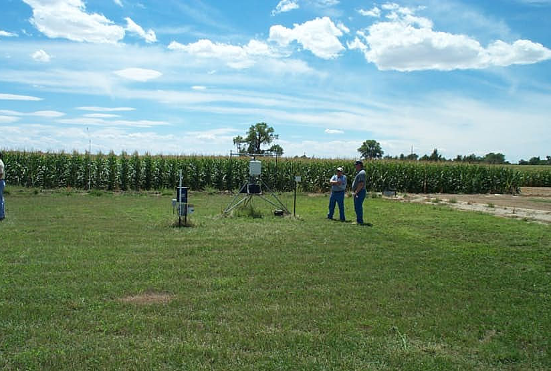
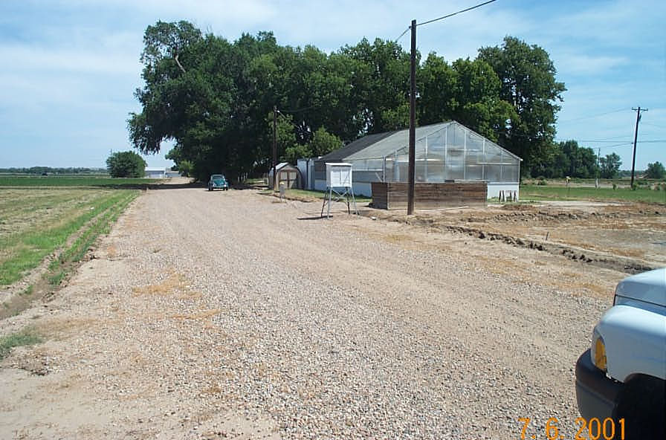
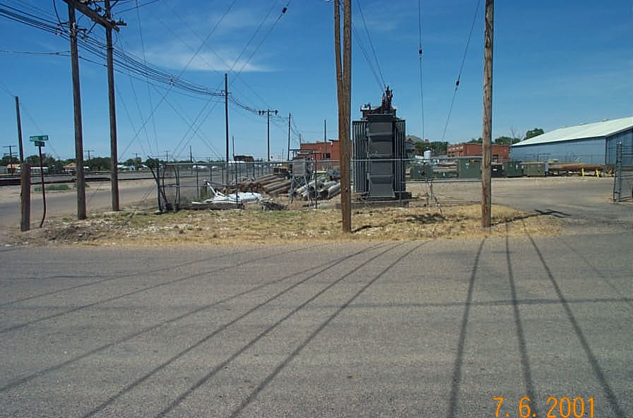
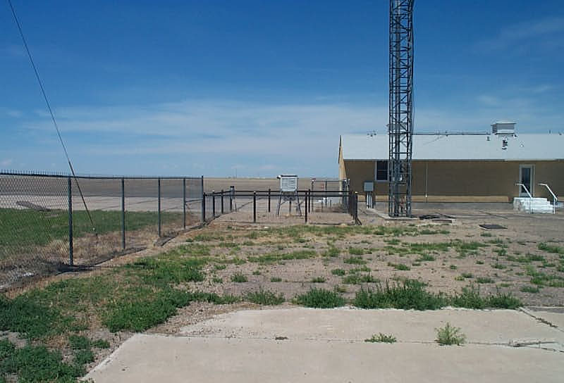
Coefficients for one EWS-NOAA station pair generally not applicable at other NOAA stations when conditions at the NOAA sites are dissimilar
Rocky Ford CoAgMet
Rocky Ford NOAA
Las Animas NOAA
La Junta NOAA

Slide 17
